Slide 1

A wind tunnel for kids…
Status Update
October 13, 2011

Slide 2
Activities this week
Preliminary Design work
SRS Draft almost complete
Physical Wind Tunnel control board prototyping
Virtual Wind Tunnel UI mockup
Identified High Risk Items

Slide 3
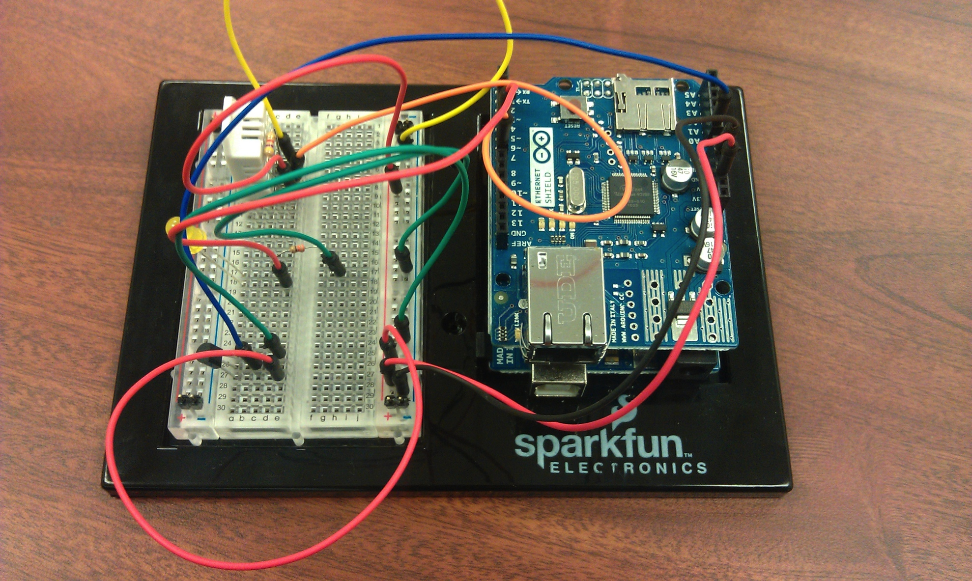
Chris’ arduino + ethernet + protoboard
Will control Physical Tunnel sensors and actuators
See https://pachube.com/feeds/36705 for a
report of measurements taken from this board

Slide 4
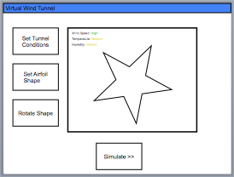
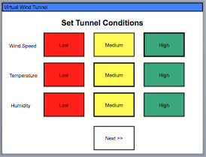
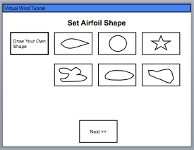
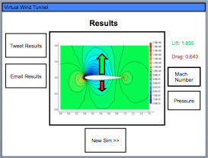
Brian’s virtual tunnel UI mockup
A walk through of how the UI will flow
See http://goo.gl/yb384 for the full mockup

Slide 5
High Risk Items
Physical Tunnel
Virtual Tunnel
- I/O count
- Cost
- >1 Arduino communication
- Fan
- RPM measurement
- Control
- On board web-server
- Model positioning system
- Physical controls
- I/O count
- Child proof
- whiteboard drawing of shape
- translating shape into computational grid
- porting solver to Android NDK
- speed and stability issues
- translating solver output to lift, drag info
- translating solver output to pretty picture

Slide 6
Workload
 | Requirements | Design | Code | Documentation | Total
Josh Calahan | 9 |  |  | 1 | 10
Wes Cothran | 10 |  |  |  | 10
Chris Davis |  | 10 |  |  | 10
Michael Lynch | 9 |  |  | 1 | 10
Brian Pittman |  | 8 |  | 2 | 10
Totals | 28 | 18 |  | 4 | 50

Slide 7

Follow us on Twitter… 4 followers – 47 tweets
@TunnelK
Notes:
Initial social network of choice…

